Slide 1


Slide 2


Mr. Stefano
IRREGULAR
VERBS

Slide 3

IRREGULAR VERBS ARE VERBS THAT DO NOT FOLLOW THE REGULAR PATTERN OF ADDING "-ED" TO FORM THE PAST TENSE. THEY HAVE THEIR OWN UNIQUE FORM FOR THE PAST TENSE.
CAN YOU SELECT THE CORRECT IRREGULAR VERB IN THE FOLLOWING SENTENCES?

Slide 4
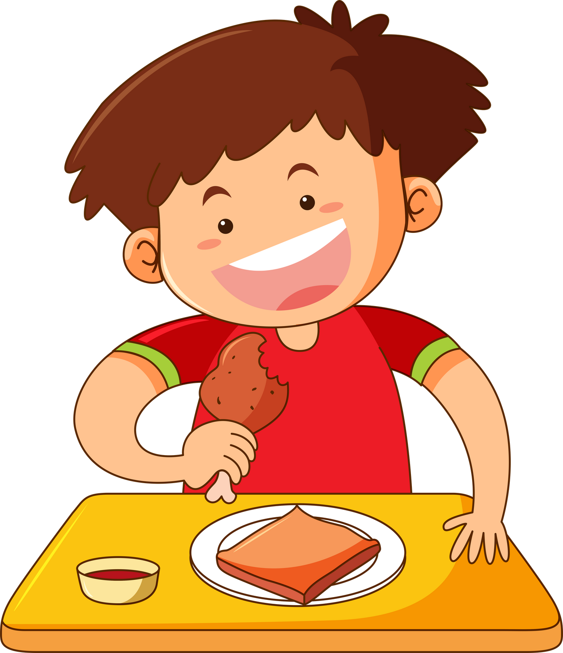
sat
sitted
satted
The boy
at the table.

Slide 5
sat
sitted
satted
The boy
sat
at the table.

Slide 6
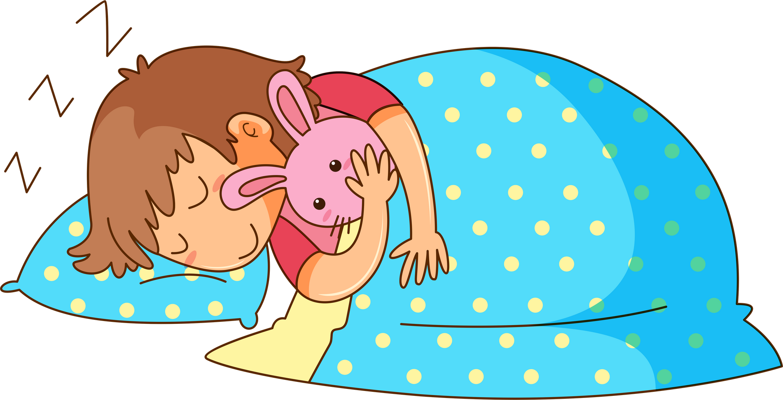
Ella
hidded
under the bed.
hid
hiding

Slide 7
Ella
hidded
hid
under the bed.
hid
hiding

Slide 8
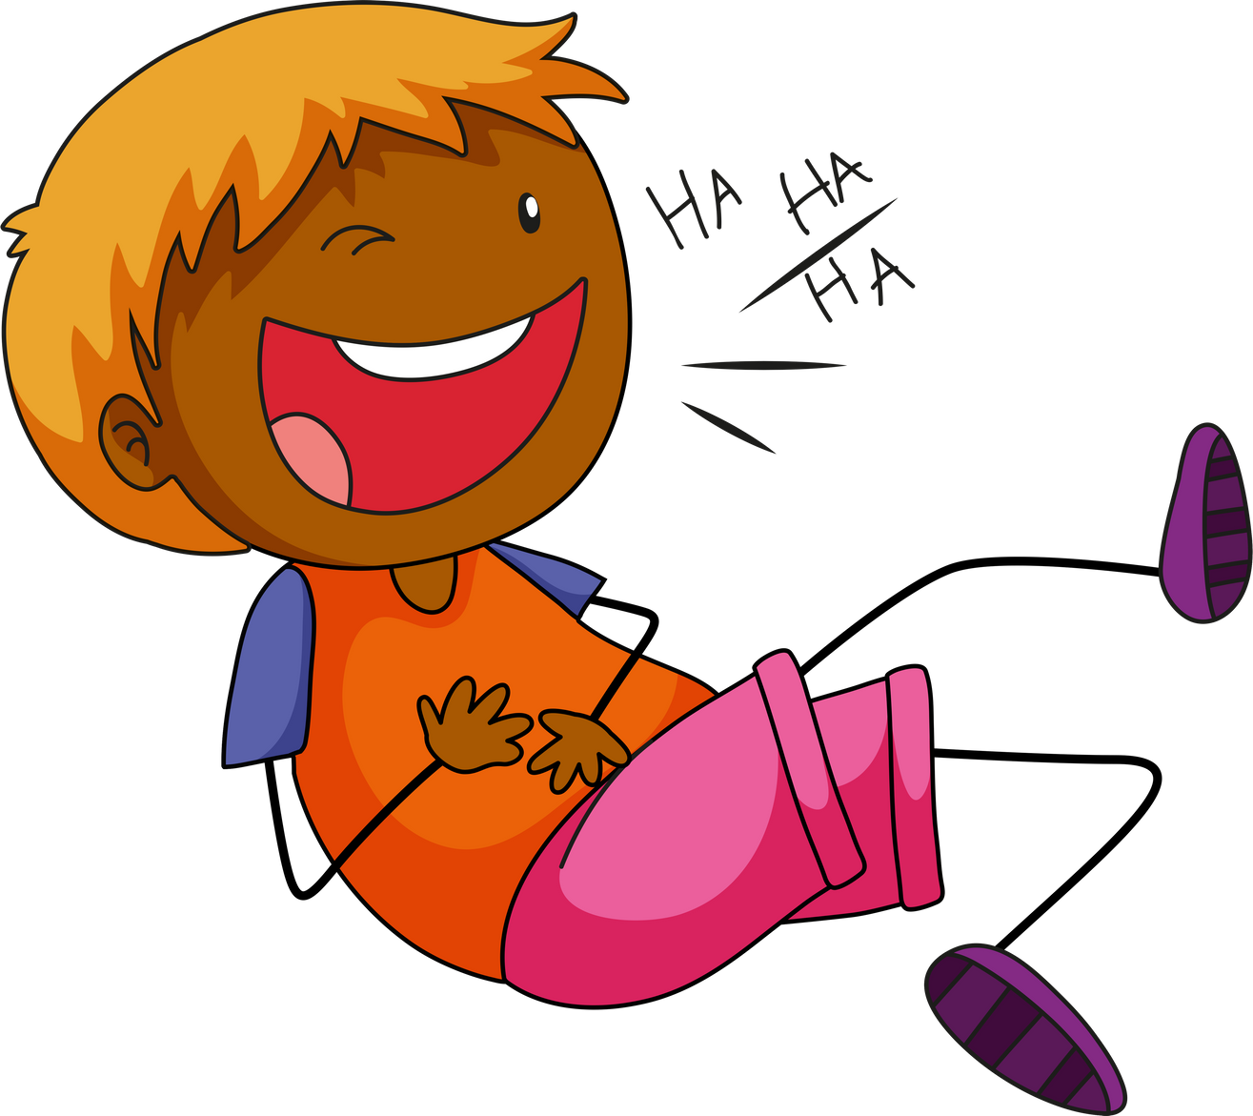
Miss Smith
me a joke.
told
telled
tolded

Slide 9
Miss Smith
told
me a joke.
told
telled
tolded

Slide 10
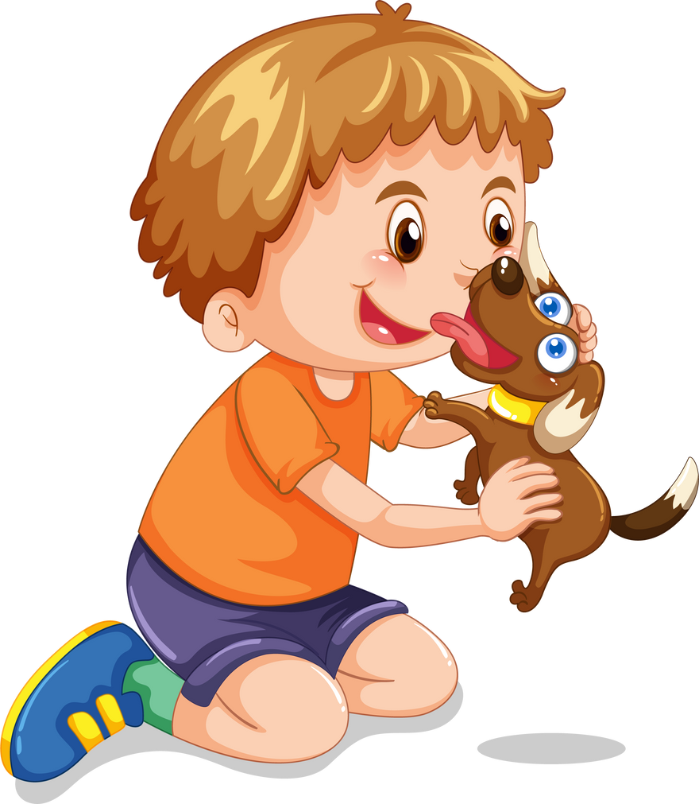
hold
Can you
the puppy please?
holded
helded

Slide 11
hold
Can you
hold
the puppy please?
holded
helded

Slide 12

rang
ranged
runged
My mom
her friend.

Slide 13
rang
ranged
runged
My mom
rang
her friend.

Slide 14

Jane
seed
a big rainbow.
saw
sawed

Slide 15
Jane
seed
saw
a big rainbow.
saw
sawed

Slide 16
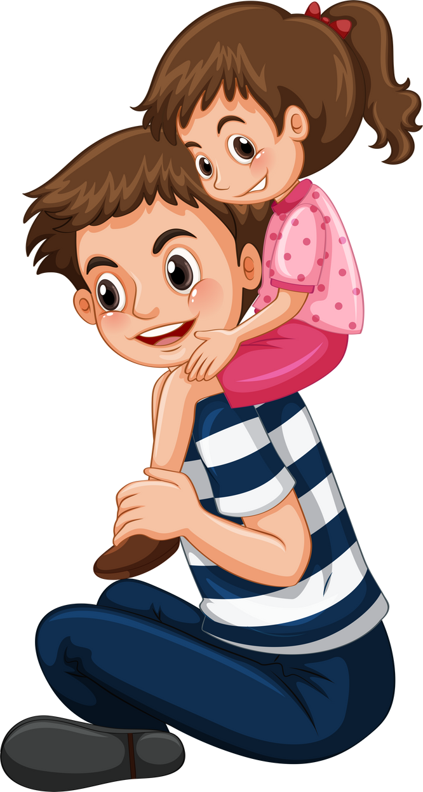
Daddy
he loves me.
sayed
said
saided

Slide 17
Daddy
said
he loves me.
sayed
said
saided

Slide 18
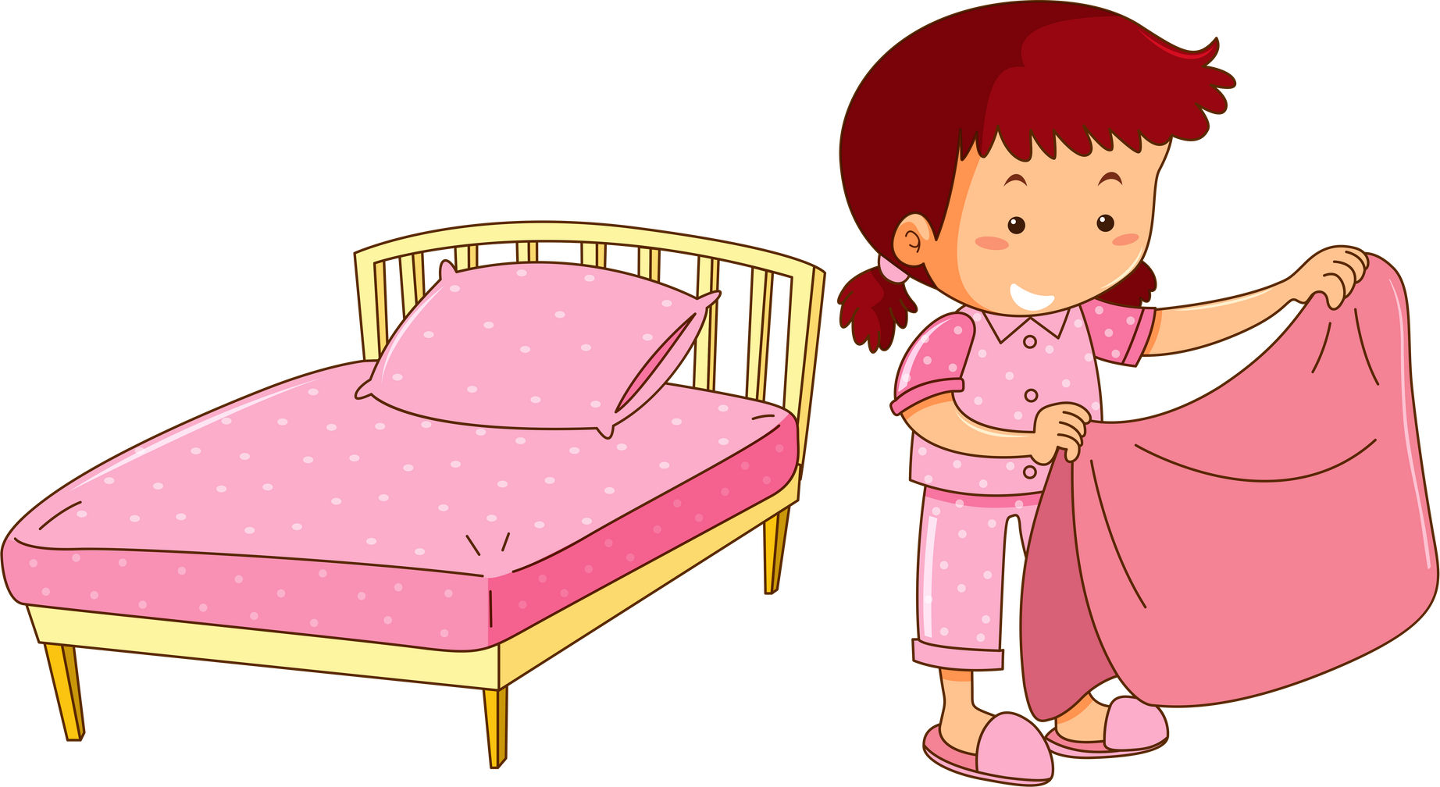
maked
Ally
the bed.
maded
made

Slide 19
maked
Ally
made
the bed.
maded
made

